Slide 1
DATA SCIENCE pokemon analysis
Team Member:林冠宇、黃子瑋、蔡政融

Slide 2
Feature Engineering
01

Slide 3
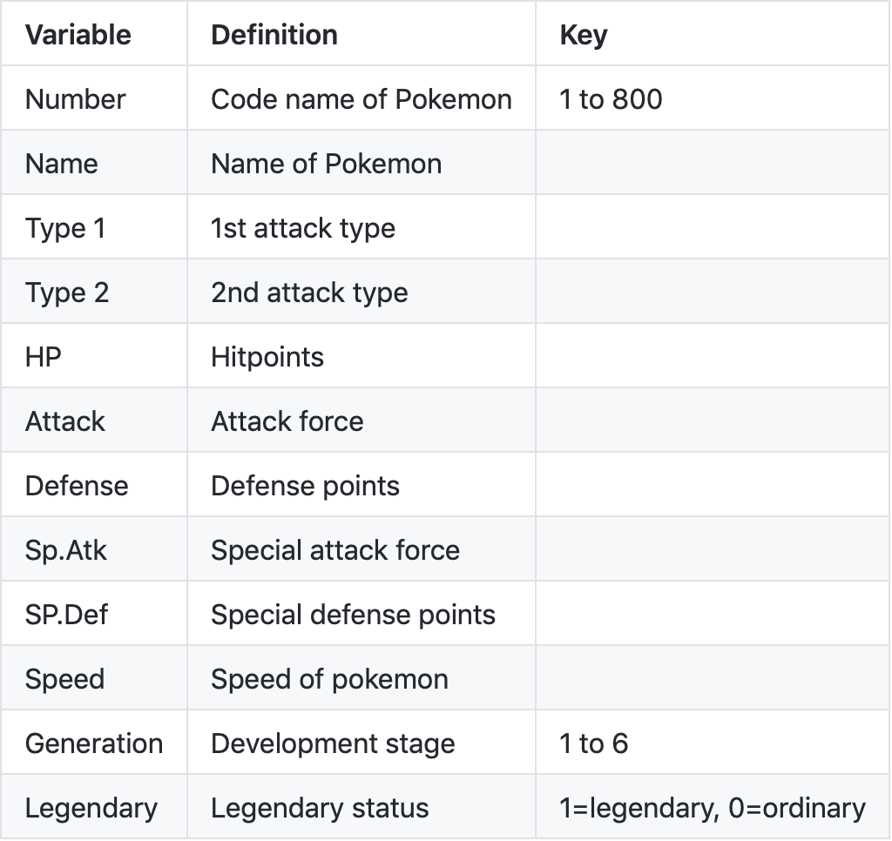
Input
Data source : kaggle dataset
Input format : csv file
The data set contains 12
variables

Slide 4
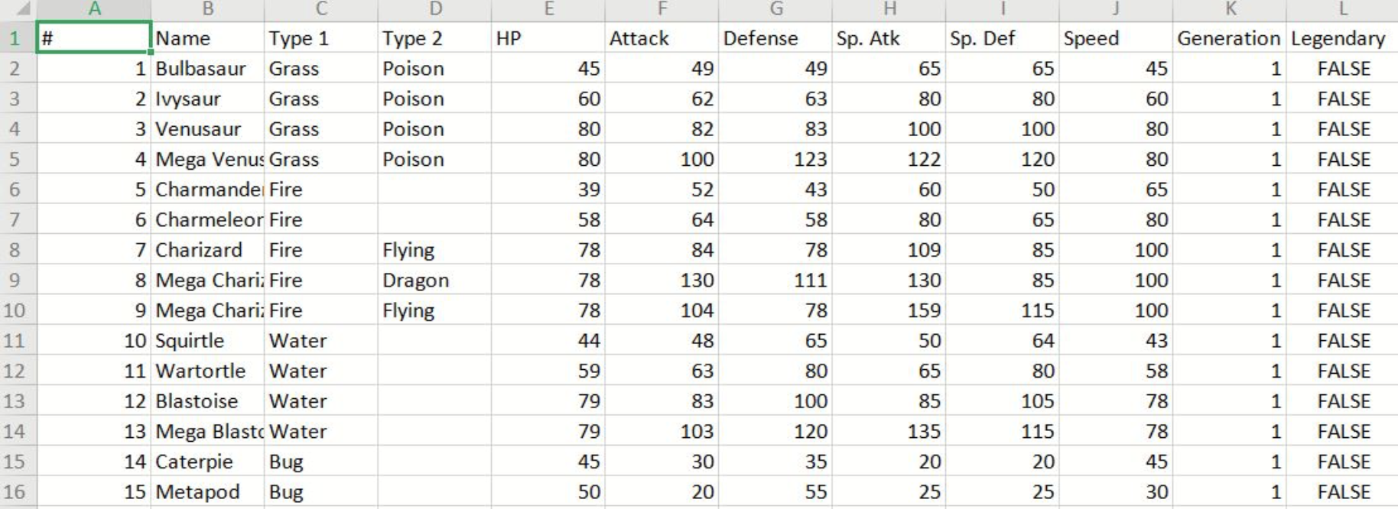
Feature Engineering
pokemon.csv

Slide 5
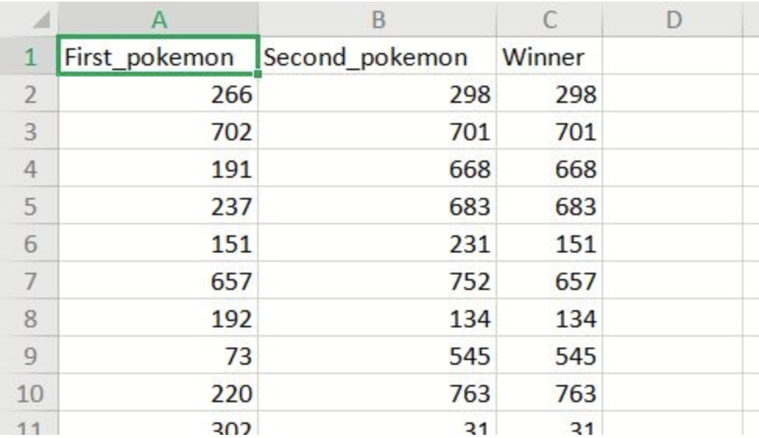
Feature Engineering
combats.csv

Slide 6
Feature Processing
target
Calculate "Win rate" : We record the number of games and divide the individual wins by the total number of games played to calculate the win rate.
"Mega" variable creation : We have specially selected whether it is Mega Pokemon for EDA to see if it will have an impact on victory.

Slide 7
Feature engineering
Missing value
In our dataset, three pokemon's name are missing.
There is a Pokemon that is divided into male and female and has a gender symbol next to the name label, which causes an error when reading the dataset. We also fixed this problem manually.

Slide 8
Model Selection
02

Slide 9
Model Selection
Data transition
3 models
Evaluation

Slide 10
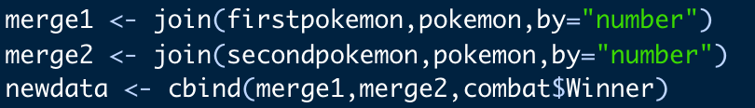
Data transition
Merge two input files
Notes:
變數的處理(就像是分成ab兩個寶可夢進入對戰組合)
2. 有沒有變數要做轉換(例如True False轉1 0)
3. 甚麼模型、展示結果(可能要用cmd跑一下)

Slide 11
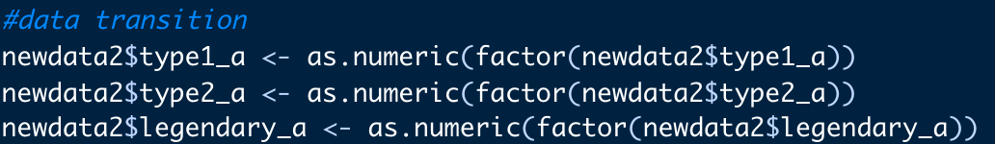
Data transition
From character to numeric
Notes:
變數的處理(就像是分成ab兩個寶可夢進入對戰組合)
2. 有沒有變數要做轉換(例如True False轉1 0)
3. 甚麼模型、展示結果(可能要用cmd跑一下)

Slide 12
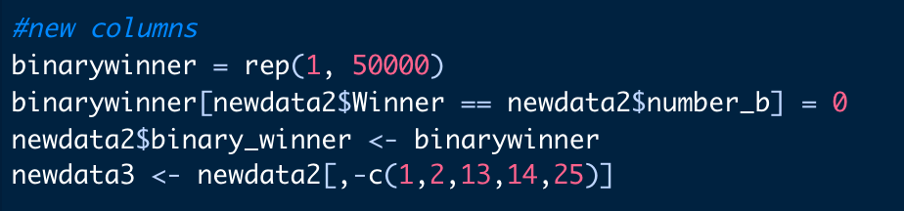
Data transition
Delete unnecessary columns and create a column called “binarywinner” as label
Notes:
變數的處理(就像是分成ab兩個寶可夢進入對戰組合)
2. 有沒有變數要做轉換(例如True False轉1 0)
3. 甚麼模型、展示結果(可能要用cmd跑一下)

Slide 13
Data transition
From character to numeric
Notes:
變數的處理(就像是分成ab兩個寶可夢進入對戰組合)
2. 有沒有變數要做轉換(例如True False轉1 0)
3. 甚麼模型、展示結果(可能要用cmd跑一下)

Slide 14
Models
Logistic regression
Random Forest
XGboost
Notes:
變數的處理(就像是分成ab兩個寶可夢進入對戰組合)
2. 有沒有變數要做轉換(例如True False轉1 0)
3. 甚麼模型、展示結果(可能要用cmd跑一下)

Slide 15
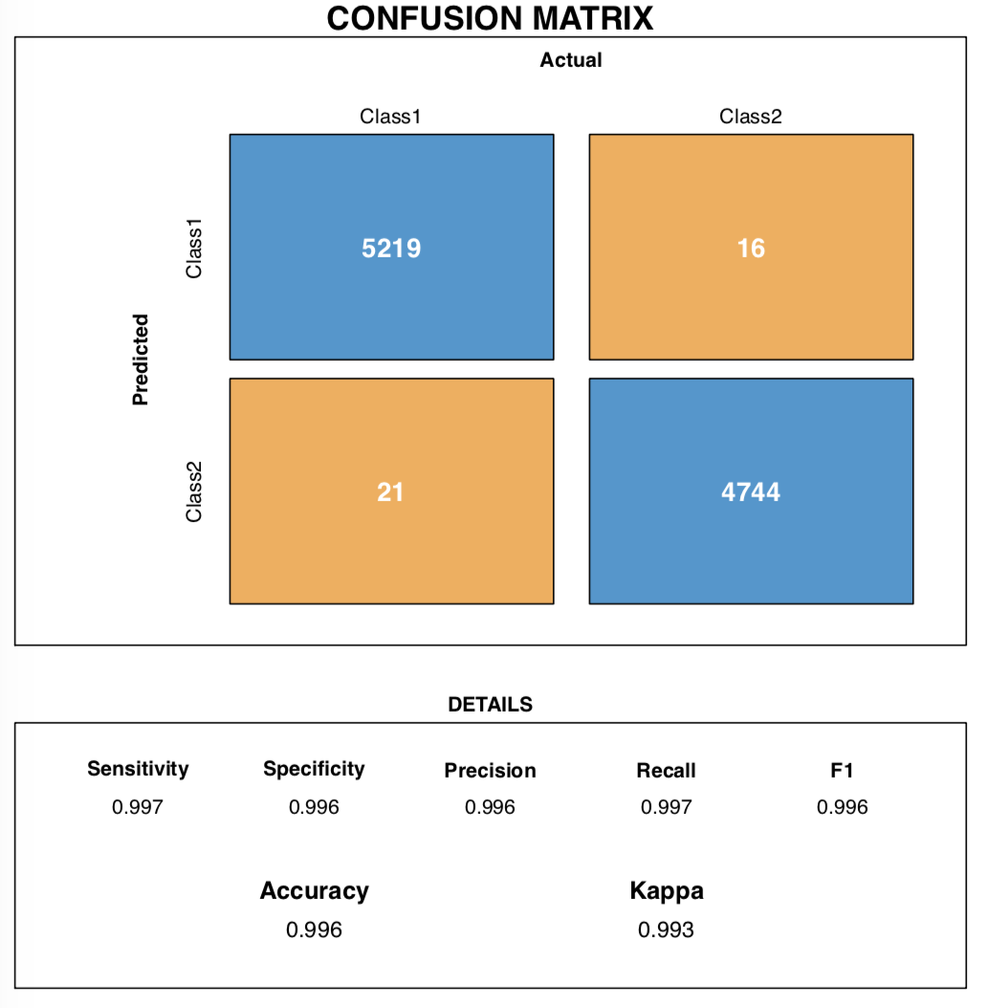
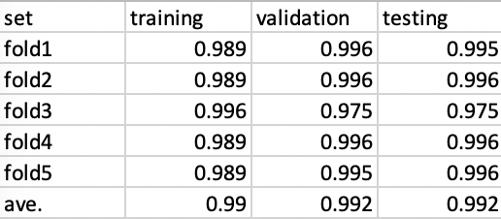
Evaluation
Random Forest as example
Csv & confusion matrix
Notes:
變數的處理(就像是分成ab兩個寶可夢進入對戰組合)
2. 有沒有變數要做轉換(例如True False轉1 0)
3. 甚麼模型、展示結果(可能要用cmd跑一下)

Slide 16
Demo
03
https://ziweihuang.shinyapps.io/FinalProject/

Slide 17
Improvements
04

Slide 18
Bonus
Mega Rayquaza
Total battle numbers: 134 games(10 with same opponents)
Win rate: 94.78% (win 127 games, loss 7 games)
Question:
According to the conclusion of our EDA, "Mega Rayquaza" is a Pokémon that ranks in the top ten in total ability, but why the win rate does not even ranks in the top ten?
Notes:
總對戰場數為134場
•其中與124隻不同的寶可夢對戰過，也就是有10場對戰是和重複的寶可夢對戰
•其勝率為94.78% (贏了127場，輸了7場)
•問題：
•根據我們EDA的結論，「Mega 烈空座」是全能力值加總排進前十甚至前三的寶可夢，但為什麼勝率連前十都排不進？
→因此後續將分析「Mega 烈空座」的失敗場次來找出原因

Slide 19
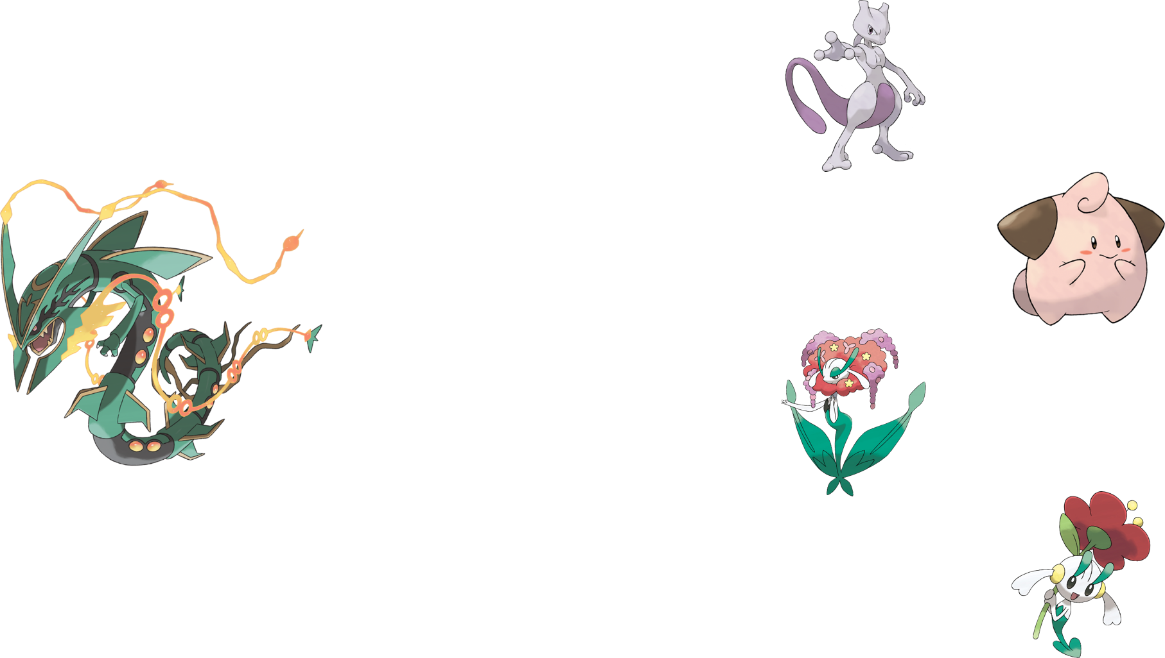
Improvements
Lose to Mewtwo 超夢
(Normal & Mega-X & Mega-Y)
Lose to Cleffa 皮皮寶 twice
Lose to Florges 花傑夫人
Lose to Floette 花葉蒂

Slide 20
Improvements
Among them, Mewtwo is "Legendary" Pokémon, and the total ability is similar to "Mega Rayquaza ".
The other three Pokémon are general Pokémon (non-legendary), and their win rate is not high.
Win rate:
Cleffa 皮寶寶: 6.25%
Florges 花傑夫人: 62.81%
Floette 花葉蒂: 39.67%
They are all "Fairy" Pokémon !
They are only the 3 Fairy Pokémon that Mega Rayquaza Battle
** Note: Florges花傑夫人 is the evolutionary pattern of Floette花葉蒂
Notes:
其中「超夢」以及超夢的「Mega X & Mega Y」型態為”傳說級”寶可夢，其能力值總和如同「Mega 烈空座」也在前段班，甚至比烈空座還高。
•其餘三隻寶可夢皆為一般寶可夢(非傳說)，且勝率並不高
•勝率：
•皮寶寶：6.25%
•花傑夫人：62.81%
•花葉蒂：39.67%
→ 但共同點為皆為「妖精屬性」寶可夢！
(也是Mega 烈空座唯3對戰的妖精屬性寶可夢)
**註：花傑夫人為花葉蒂的進化型

Slide 21
Improvements
Facing the legendary Pokémon (this refers to Mewtwo):
A little lower total ability may be a reason to loss
Mewtwo is a "Psychic" Pokemon, the Mega Rayquaza is a "Dragon + Flying" Pokemon, and there is no advantage or disadvantage in the type.
Facing other general Pokémon:
"Fairy" restrains "Dragon" (Fairy moves attack Dragon and damage multiplied by 2)
In addition, after detailed exploration of skill moves, we found that all three Pokémon have moves that reduce the ability of opponents.
E.g : Cleffa 's "Angel Kiss" 天使之吻 effect is "Make opponents confused"
The "Mist Field" 薄霧場地 of Florges and Floette effect is "Make Dragon-type moves reduced by 50% damage"
Notes:
•面對傳說級寶可夢(這裡指的是超夢)：
•總能力值較低可能是一大原因
•而超夢為「超能力」屬性，Mega 烈空座為「龍系 +飛行」屬性，屬性上並無優劣勢(互相攻擊傷害均為 x1)
•面對其他一般寶可夢：
•屬性上「妖精」克制「龍」屬性(妖精系技能攻擊龍系傷害為 x2)
•另外在細部探究招式技能後，發現這三隻寶可夢皆有降低對手能力的招式
•例如：
•皮寶寶的『天使之吻』效果為 “能使對手混亂”
•花傑夫人以及花葉蒂的『薄霧場地』效果為 “受到的龍屬性招式的傷害降低50%”
•
•結論：除能力值外，屬性克制也是需要考慮的重要因素！

Slide 22
Improvements
Conclusion :
In addition to total ability, type restraint is also an important factor to consider.
Besides, there are also moves to be consider. If we can collect data or obtain relevant data from other data sets, we think that from the previous example, the prediction results may be improved.
Notes:
•面對傳說級寶可夢(這裡指的是超夢)：
•總能力值較低可能是一大原因
•而超夢為「超能力」屬性，Mega 烈空座為「龍系 +飛行」屬性，屬性上並無優劣勢(互相攻擊傷害均為 x1)
•面對其他一般寶可夢：
•屬性上「妖精」克制「龍」屬性(妖精系技能攻擊龍系傷害為 x2)
•另外在細部探究招式技能後，發現這三隻寶可夢皆有降低對手能力的招式
•例如：
•皮寶寶的『天使之吻』效果為 “能使對手混亂”
•花傑夫人以及花葉蒂的『薄霧場地』效果為 “受到的龍屬性招式的傷害降低50%”
•
•結論：除能力值外，屬性克制也是需要考慮的重要因素！

Slide 23
THANK you for listening

